Slide 1

File InputOutput (I/O)

Slide 2
What is a File?
A file is a collection of 0’s and 1’s stored in a “permanent” medium
A directory (aka folder) is a way to organize files
Kind of like a file that contains files

Slide 3
Text Files and Binary Files
Files treated as a sequence of characters are called text files
Java program source code, for example, is a text file.
Any file with a .txt, .java, .doc, .pdf extension is a text file.
There are other valid extensions for text files too. These are just examples.
Can be viewed and edited with text editor. These are human-readable files.
All other files are called binary files
Movie and music files, .class files, etc
Access requires a specialized program
These cannot be easily read by humans, but can be read efficiently by computers.
This is an important distinction for Java programs because Java has different classes to handle the two kinds of files

Slide 4
The Concept of a Stream
In Java, file I/O, as well as simple keyboard and screen I/O, is handled by streams.
A stream is a flow of data
Characters
Numbers
Bytes
If the data flows into your program, the stream is called an input stream.
If the data flows out of your program, the stream is called an output stream.
Program
File
Output Stream
Input Stream

Slide 5
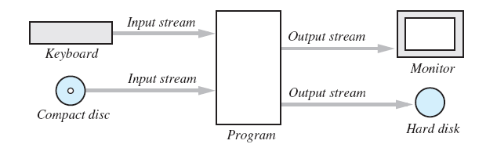
The Concept of a Stream
For example, if a stream is connected to the keyboard, the data flows from the keyboard into your program, hence it’s an input stream.
For example, if a stream is connected to the monitor, the data flows from your program out to the monitor, hence it’s an output stream.

Slide 6
The Concept of a Stream
Streams are implemented as objects of special stream classes
An object of the class Scanner, which we have been using for keyboard input, is an input stream.
The object System.out is an example of an output stream that we have used.
Today we will be discussing streams that connect your program to files instead of the keyboard or the display

Slide 7
Why Use Files for I/O?
Keyboard input and screen output deal with temporary data
When the program ends, the data is gone
Data in a file remains after the program ends
Can be used next time the program runs
This is especially helpful if a lot of input data is required
Can be used by another program without needing to type the data again for each program

Slide 8
Creating a Text File
Class FileOutputStream defines methods needed to create and write to a text file
Must import package java.io
To open the file
Declare variable for referencing the stream
Invoke FileOutputStream constructor and pass file name as argument
Requires try and catch blocks
String fileName = "out.txt";
FileOutputStream outputStream = null;
try {
outputStream = new FileOutputStream(fileName);
outputStream.close();
}
catch(FileNotFoundException fnfe) {
System.out.println("Error opening the file " + fileName);
}
catch(IOException ioe) {
System.out.println("I/O error");
}
Notes:
Demonstrate how the compiler would inform the user that a try-catch is needed.
Also demonstrate how the Java API shows this.

Slide 9
Closing a Text File
After we finish writing the entire text file, we disconnect the stream from the file. That is, we close the stream connected to the file by writing
outputStream.close();
If you do not close a stream, Java will close it for you when the program ends.
But if an exception occurs before Java automatically closes the stream, you could end up with a file that is left open and cannot be written to by other programs. So it is best to close it manually.

Slide 10
Appending to a Text File
Opening a new file begins with an empty file
If the file already exists, it will be overwritten
Some situations require appending data to an existing file
Command could be PrintStream ps = new PrintStream( new FileOutputStream(fileName, true));
If the file didn’t already exist, a new empty file would be created
Method println appends data at the end of the file, whether it already exists or is empty

Slide 11
Reading from a Text File
We can use a Scanner object to read from a file, similar to how we use Scanner to read from the keyboard (passing in System.in as the argument)
We have to instantiate Scanner like so to read from a file:
Scanner streamName = new Scanner(new File(fileName));
Must surround it in try-catch block because it can throw a FileNotFoundException

Slide 12
Reading from a File
public class Test {
public static void main(String[] args) {
Scanner inputStream = null;
try {
inputStream = new Scanner(new File("out.txt"));
}
catch(FileNotFoundException fnf) {
System.out.println("Couldn’t find the file");
System.exit(1);
}
while(inputStream.hasNextLine()) {
String line = inputStream.nextLine();
System.out.println(line);
}
}
}

Slide 13
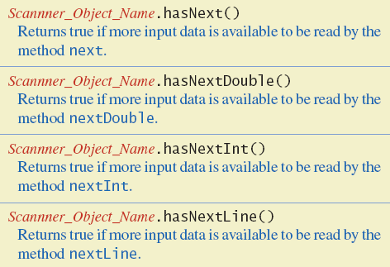
Reading from a Text File
All the methods of Scanner that we have used before are still available to us and work in the same way.
Below are some additional methods in class Scanner that you may not have seen or used before

Slide 14
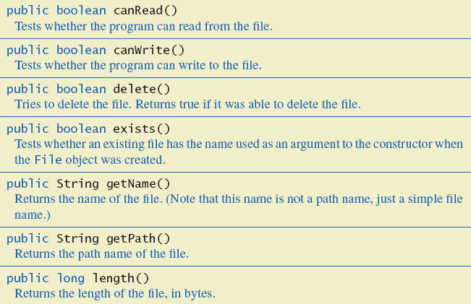
The Class File
The File class is an abstract representation of a file
It is not an input stream or output stream
It allows you to perform operations on the file (but not writing to or reading from)

